Slide 1


Slide 2
The goal

Slide 3

Simplify Campus
Administration

Slide 4
As a Campus administrator
I want to be able to
upload the presentation And video after
a session and share it in ONE

Slide 5







MP4
Webm
PPTX / PDF
flv
Admin
DB
Sessions
PPTX / PDf

Slide 6
The Vision

Slide 7


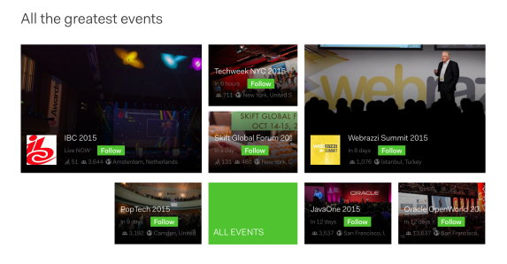




User
DB
Sessions
Events
Speakers
Admin

Slide 8
THE MEN
BEHIND the tool
Andreas
Michael
Thomas

Slide 9
Where art thou?

Slide 10
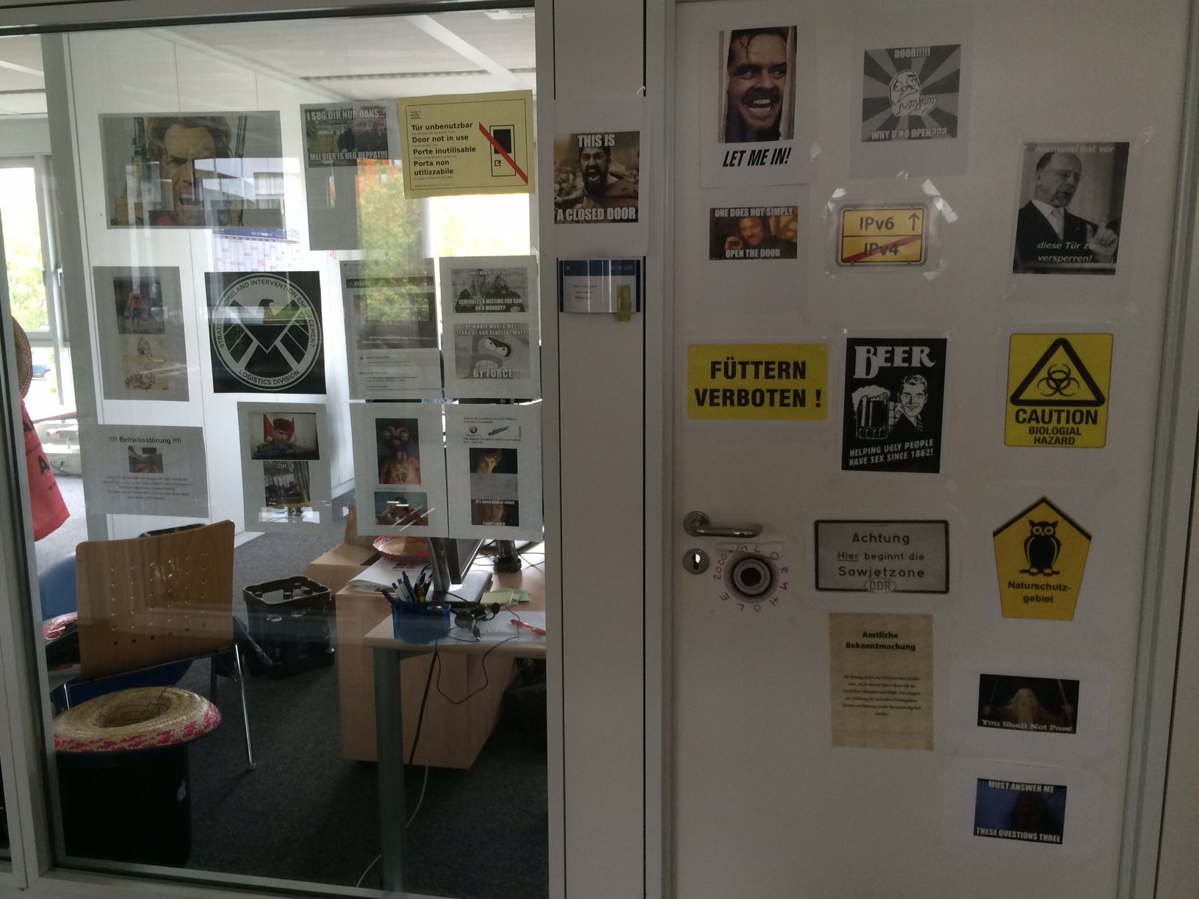

Slide 11
How will you
Do it?

Slide 13
MAY
THE
HACKING
BEGIN!

